Slide 1

A0597203 AI Business Applications
Introduction to Machine Learning

Slide 2
AI Business Applications
Introduction to Machine Learning

Slide 3
Introduction to Machine Learning
In this part of the course, we will cover 3 algorithms in Machine Learning:
Regression (Supervised Learning)
Classification (Supervised Learning)
Clustering (Unsupervised Learning)

Slide 4
What Is Linear Regression?
Purpose: Predict a continuous numeric outcome (dependent variable) using one or more independent variables.
Use Case Example:
Problem | Example Features
House Price Prediction | Location, size (sqft), number of bedrooms, age of property
Sales Forecasting | Advertising budget, seasonality, past sales, promotions
Stock Price Prediction | Trading volume, past prices, news sentiment, technical indicators
Temperature Prediction | Date, time of day, humidity, wind speed, cloud cover
Medical Cost Estimation | Age, BMI, smoking status, number of children, region

Slide 5
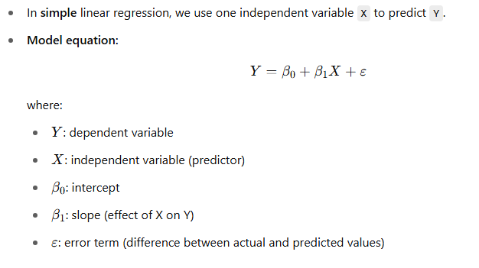
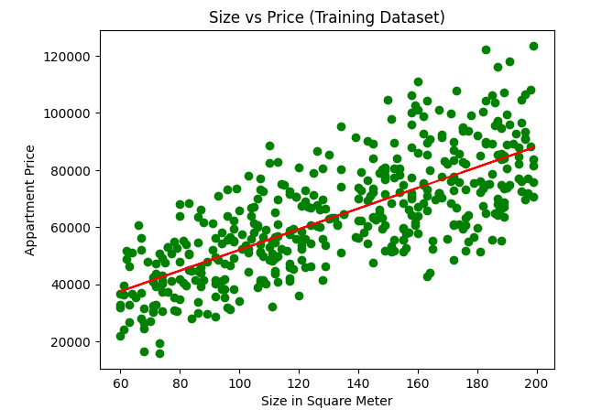
Simple Linear Regression

Slide 6
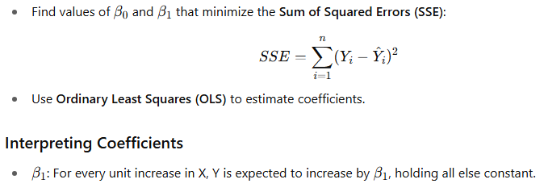
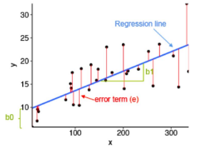
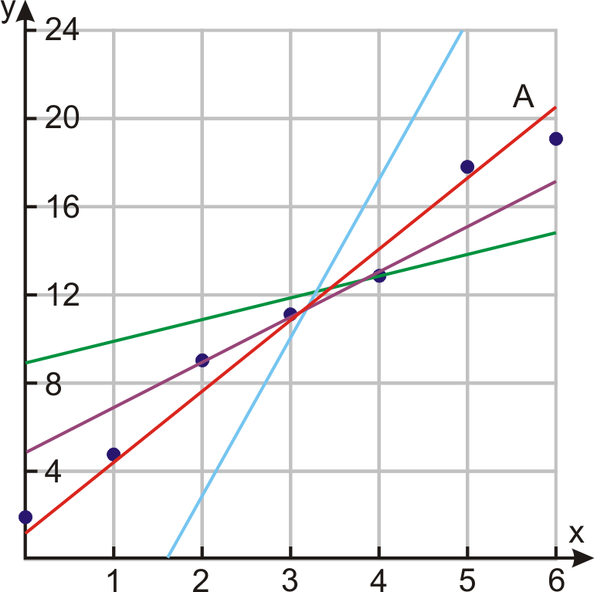
Goal of Regression

Slide 7
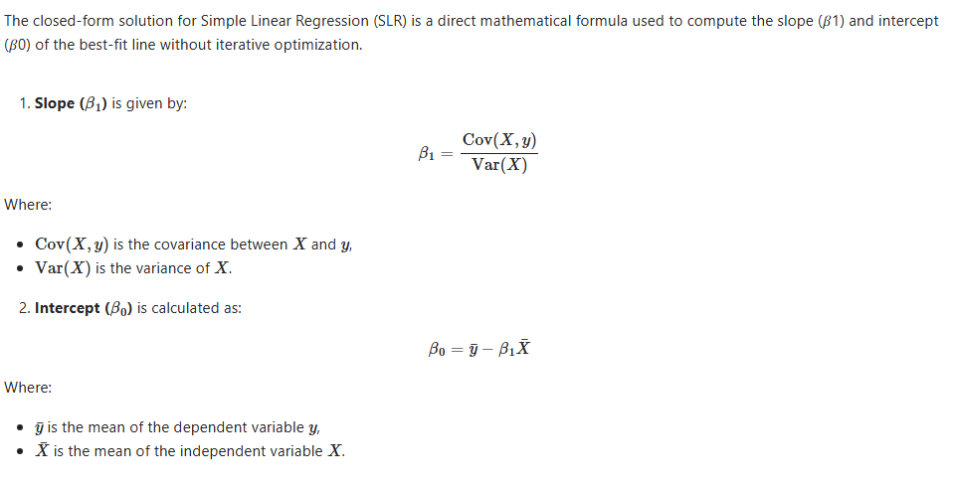
Solving Simple Linear Regression using the Closed Form Method

Slide 8
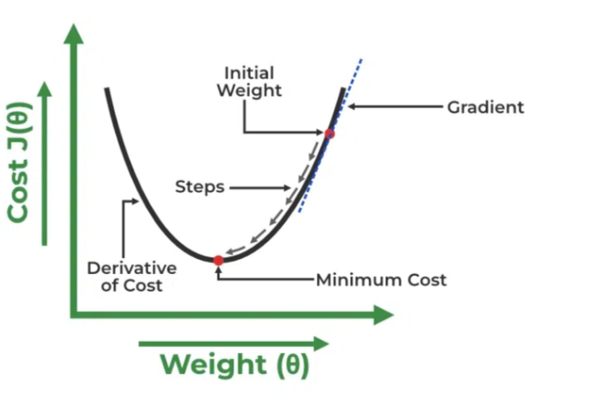
Solving Regression using the Gradient Descent Method
A linear regression model can be trained using gradient descent method, which adjusts the model's parameters to minimize the mean squared error (MSE).
To update the Intercept (Beta 0) and the Slope (Beta 1) and reduce the cost function (minimizing the RMSE).
Gradient descent starts with random values for the Intercept and the Slope and iteratively improves them to find the best-fit line.
A gradient is simply the derivative, showing how small changes in inputs affect the output.
By moving in the direction of the Mean Squared Error negative gradient with respect to the coefficients, the coefficients can be changed.

Slide 9
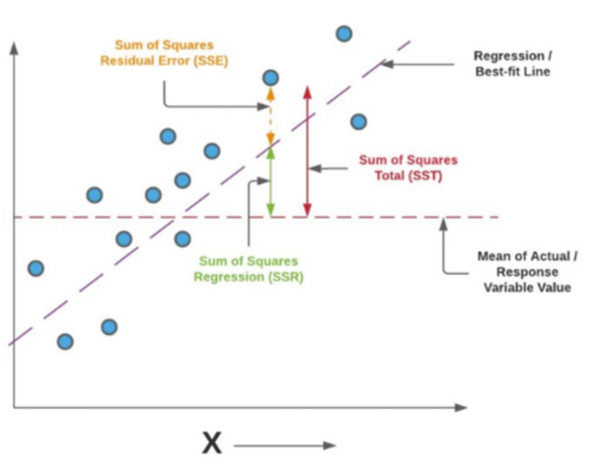
Model Evaluation Metrics
1. Total Sum of Squares (SST) Measures the total variance in the actual data. Formula: SST = Σ(yᵢ − ȳ)² Interpretation: How much the actual values vary from their mean.
2. Sum of Squares for Error (SSE) Measures the unexplained variance (residuals). Formula: SSE = Σ(yᵢ − ŷᵢ)² Interpretation: How far the predictions are from the actual values.
3. Sum of Squares for Regression (SSR) Measures the variance explained by the regression model. Formula: SSR = Σ(ŷᵢ − ȳ)²
Interpretation: How much of the variation is captured by the model.
Relationship Between the Three SST = SSR + SSE
4. R-squared (R²) Proportion of total variance explained by the model. Formula: R² = 1 − (SSE / SST) Range: 0 to 1. Higher R² indicates better fit.
5. Mean Squared Error (MSE) Average of the squared residuals. Formula: MSE = SSE / n Used to assess the model's prediction error.
6. Root Mean Squared Error (RMSE) Square root of MSE. Formula: RMSE = √MSE

Slide 10
Classification

Slide 11
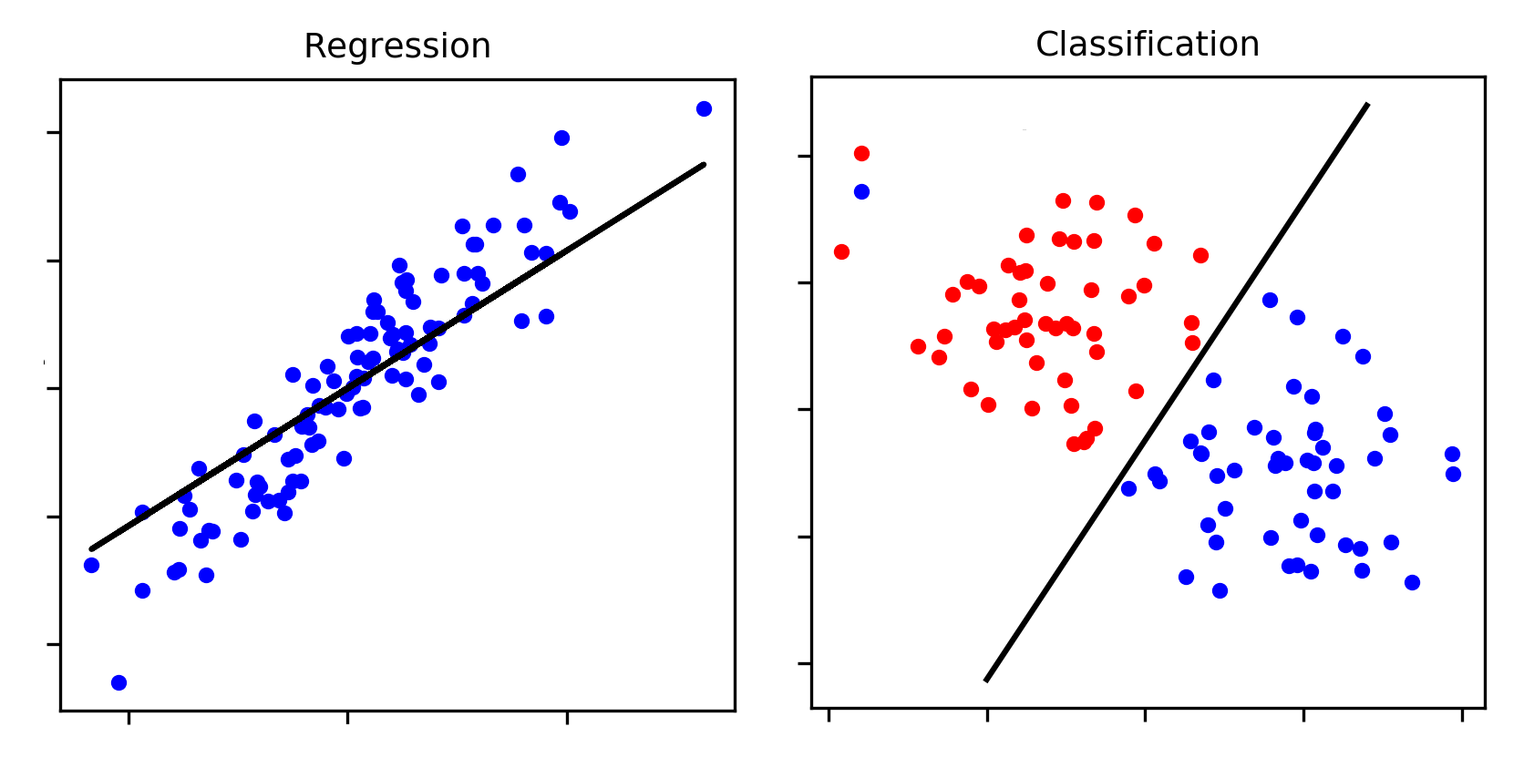
What is Classification?
Classification is a type of supervised learning where the goal is to predict a categorical label (like "yes" or "no") instead of a continuous value.
Examples:
Predicting if an email is spam or not
Determining if a customer will make a purchase
Medical diagnosis

Slide 12
Binary Classification Examples
Problem | Example Features
Churn Prediction | Customer tenure, monthly charges, contract type, support calls
Spam Detection | Email subject length, sender reputation, word frequency
Loan Approval | Income, credit score, loan amount, employment status
Fraud Detection | Transaction amount, location, card usage frequency
Disease Diagnosis | Age, symptoms, test results, exposure history

Slide 13
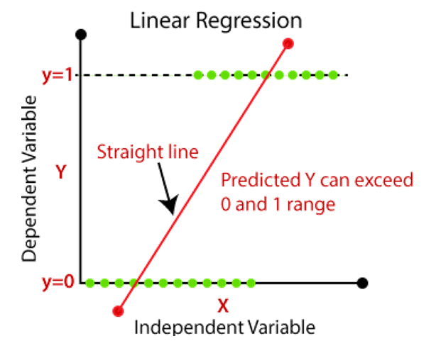
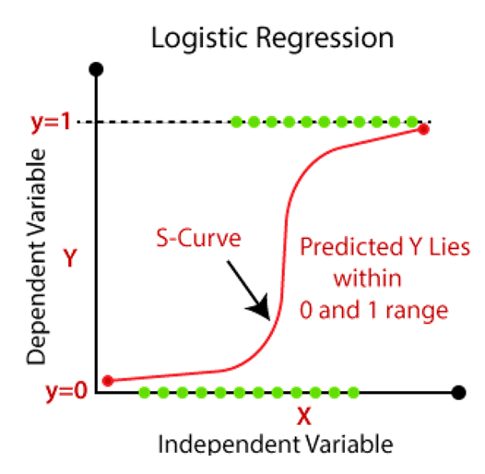
Why Not Linear Regression?
Linear Regression Problems:
Great for predicting continuous numbers (like prices)
Struggles with binary outcomes (yes/no, spam/not spam)
Can predict values outside 0-1 range
Doesn't handle categorical data well
Solution: Logistic Regression

Slide 14
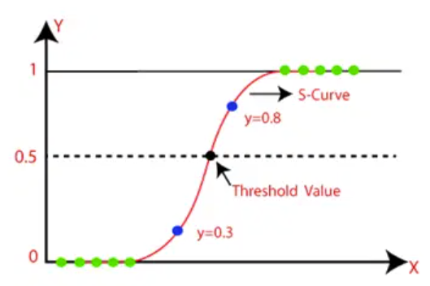

What is Logistic Regression?
Logistic regression predicts the probability that an instance belongs to a certain class.
Key Component: Sigmoid Function
How it works:
Takes any input value
Squeezes it between 0 and 1
Perfect for probability predictions!

Slide 15
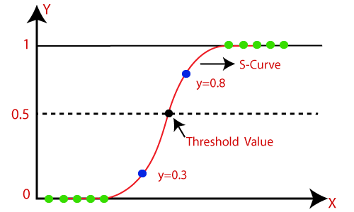
Decision Making
Classification Rules:
If probability > 0.5 → Predict "Yes" (Class 1)
If probability ≤ 0.5 → Predict "No" (Class 0)
Visual Comparison:
Linear Regression: Straight line, can go beyond 0-1
Logistic Regression: S-curve, bounded between 0-1

Slide 16
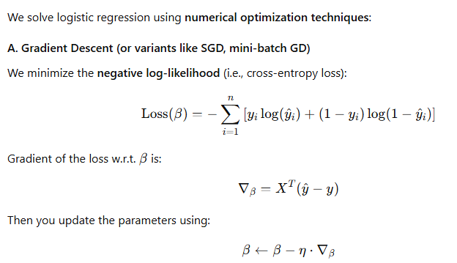
Solving Logistic Regression

Slide 17
Confusion Matrix
Use these four statistics to calculate other evaluation metrics, such as overall accuracy, true positive rate, and false positive rate
 | Predicted class positive | Predicted class negative
True class positive | TRUE POSITIVE | FALSE NEGATIVE
True class negative | FALSE POSITIVE | TRUE NEGATIVE
TRUE POSITIVE (TP): Actual and predicted class is positive
TRUE NEGATIVE (TN): Actual and predicted class is negative
FALSE NEGATIVE (FN): Actual class is positive and predicted negative
FALSE POSITIVE (FP): Actual class is negative and predicted positive

Slide 18
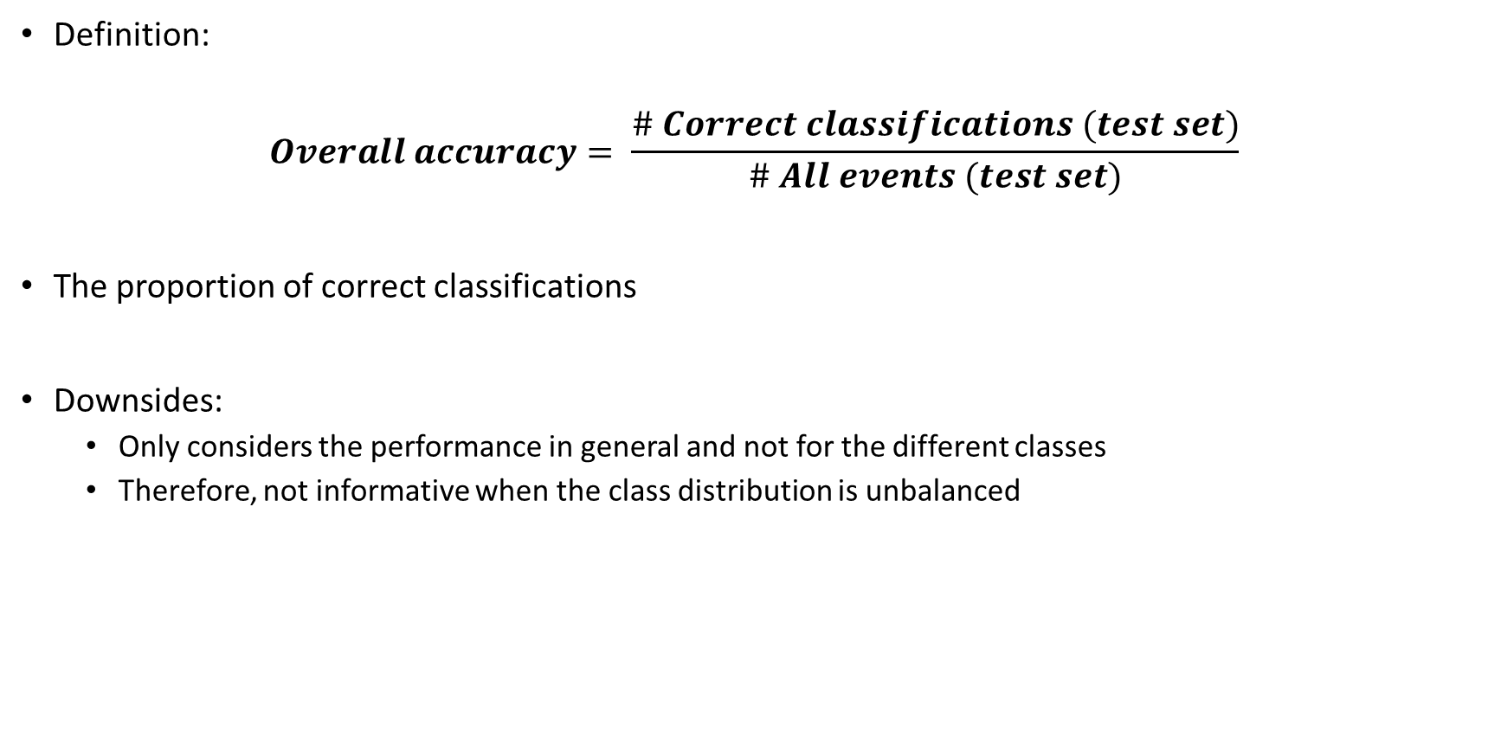
Overall Accuracy
Definition:
$$Overall accuracy= \frac{\# Correct classifications (test set)}{\# All events (test set)}$$
The proportion of correct classifications
Downsides:
Only considers the performance in general and not for the different classes
Therefore, not informative when the class distribution is unbalanced

Slide 19
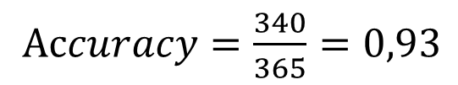
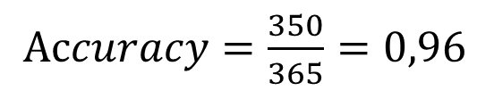
Confusion Matrix for Sailing Example
Diabetes yes / no | Predicted class: yes | Predicted class: no
True class: yes | 22 | 3
True class: no | 12 | 328
Diabetes yes / no | Predicted class: yes | Predicted class: no
True class: yes | 0 | 25
True class: no | 0 | 340
$Accuracy=\frac{350}{365}=0,96$
$Accuracy=\frac{340}{365}=0,93$
Rows – true class values
Columns – predicted class values
Numbers on main diagonal – correctly classified samples
Numbers off the main diagonal – misclassified samples

Slide 20
Unsupervised Learning
Clustering

Slide 21
What Is Unsupervised Learning?
Definition: Learning from data without labeled outcomes.
Goal: Discover hidden patterns or structures.
Contrast with Supervised Learning:
Supervised: Has labels (e.g., spam / not spam)
Unsupervised: No labels (e.g., group customers)

Slide 22
Use Cases of Unsupervised Learning
Problem | Example Features | Common Techniques
Customer Segmentation | Purchase history, age, income, browsing behavior | K-Means, Hierarchical Clustering
Anomaly Detection | Network activity, transaction amount, login frequency, location | Isolation Forest, DBSCAN, Autoencoders
Document Clustering | Word frequency, TF-IDF scores, topic distribution | K-Means, LDA (Latent Dirichlet Allocation)
Market Basket Analysis | Product IDs, purchase combinations, quantity, purchase sequence | Apriori, FP-Growth
Image Compression | Pixel intensity values, color channels, image dimensions | PCA, Autoencoders

Slide 23
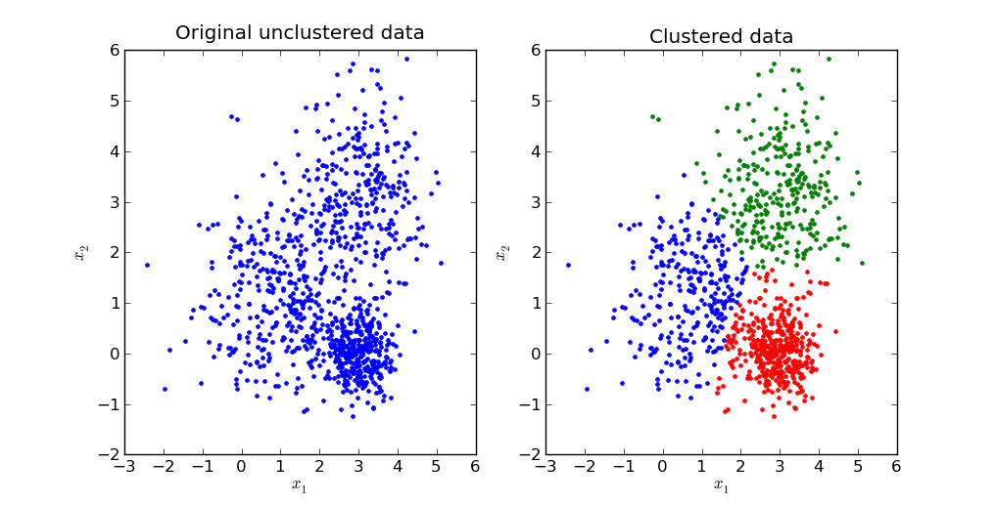
What Is Clustering?
Definition: Grouping similar data points into clusters.
Objective: Points in the same cluster are more like each other than to those in other clusters

Slide 24
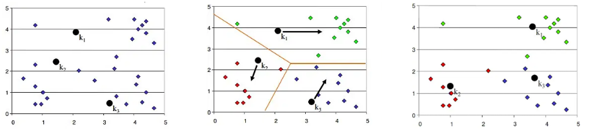
Introduction to K-Means Clustering
K-Means Clustering is an unsupervised learning algorithm used to group similar data points into K clusters, where each point belongs to the cluster with the nearest centroid (mean of the cluster).
How It Works:
Choose K: the number of clusters.
Initialize K centroids randomly.
Assign each data point to the nearest centroid.
Update centroids by calculating the mean of the assigned points.
Repeat steps 3–4 until assignments no longer change (convergence).
Goal: Minimize the within-cluster sum of squares (WCSS) — i.e., the total distance between each point and its cluster centroid.
It's simple, efficient, and widely used for tasks like customer segmentation, image compression, and pattern discovery.

Slide 25
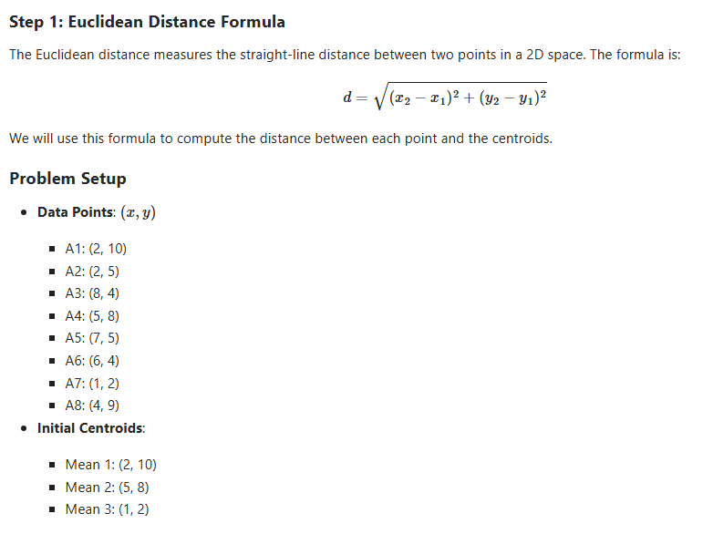
K-Means Step by Step Example

Slide 26
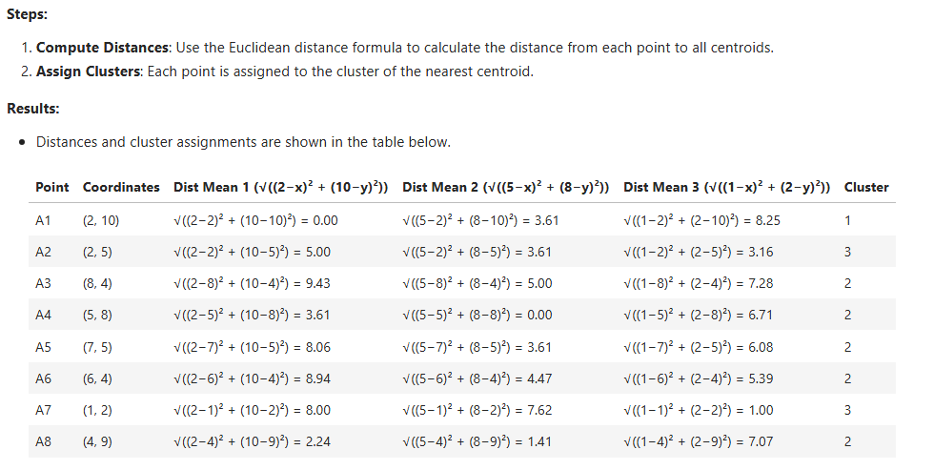
Iteration 1

Slide 27
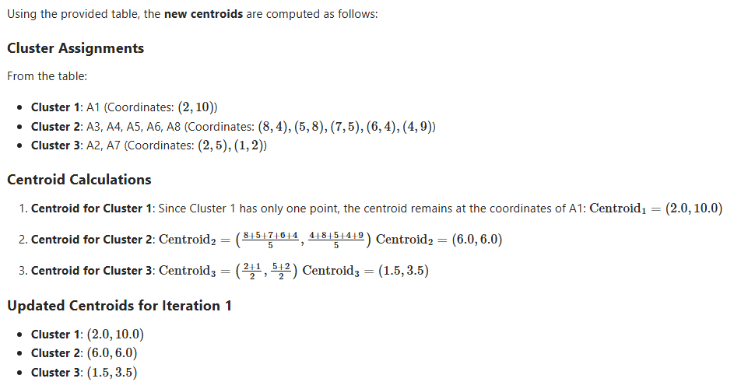
Recompute Centroids

Slide 28
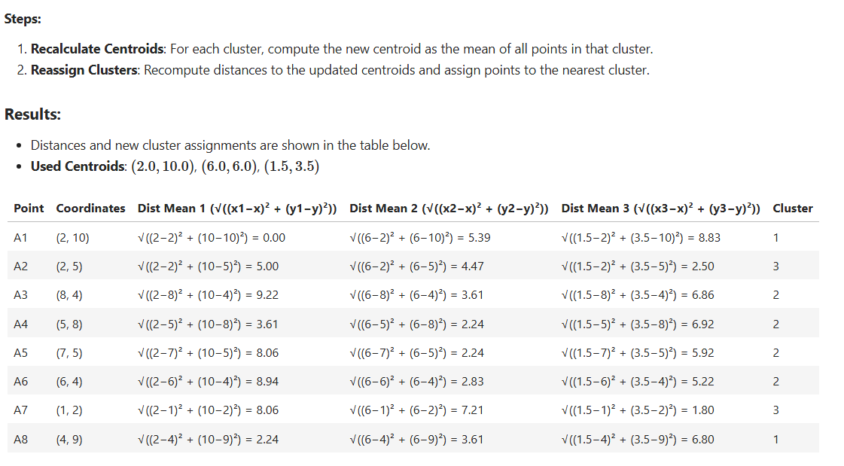
Iteration 2

Slide 29
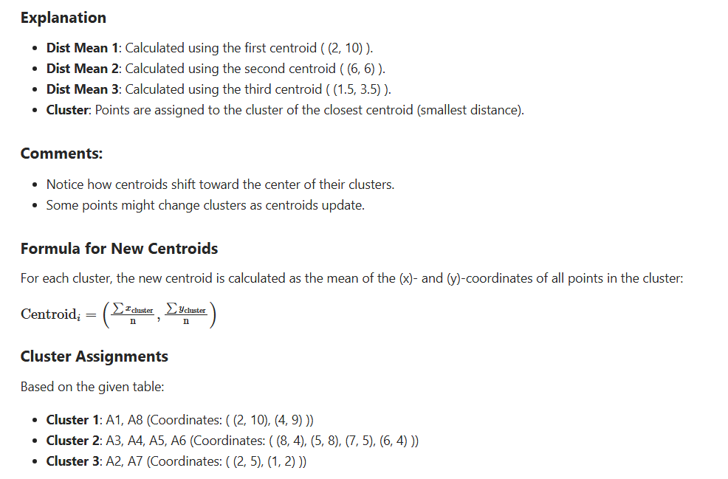
Iteration 2

Slide 30
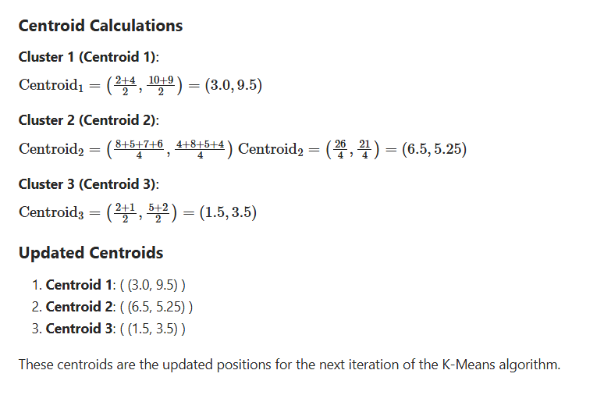
Iteration 2

Slide 31
Repeat the process until convergence
Repeat the process and compute the distance to the new centroids and move the points to their new clusters.
Keep repeating the process until the points stops changing their clusters.

